Slide 1
Using Multiple Absorbers
Buildings in Earthquakes
Bruno Iwanczyk and Nirmay Jadhav
Lab Group 87

Slide 2


Tuned Mass Dampers
Reduces amplitude of oscillation at resonance.
Dissipates energy from the building at a particular frequency.
Reduces user discomfort in structures.
Reduces likelihood of damage caused by large stresses and fatigue.
Singular TMD in most cases.

Slide 3
Goals
To explore the effects on amplitude of vibration from using multiple TMDs in buildings, each tuned to a different frequency.
To analyse the relationship between total mass of TMDs and the amplitudes of vibration.
To calculate the minimum total mass required to reduce the harmonic response to 10% of the response without absorbers.
To explore the impulse response of the structure with multiple tuned mass dampers and compare this to the frequency response.
To understand how to practically test these computer-generated predictions on a real structure during an earthquake.

Slide 4
Goals
To explore the effects on amplitude of vibration from using multiple tuned mass dampers in buildings, each tuned to a different frequency.
To analyse the relationship between total mass and the amplitudes of vibration.
To calculate the minimum total mass required to reduce the harmonic response to 10% of the response without absorbers.
To explore the impulse response of the structure with multiple tuned mass dampers and compare this to the frequency response.
To understand how to practically test these computer-generated predictions on a real structure during an earthquake.

Slide 5
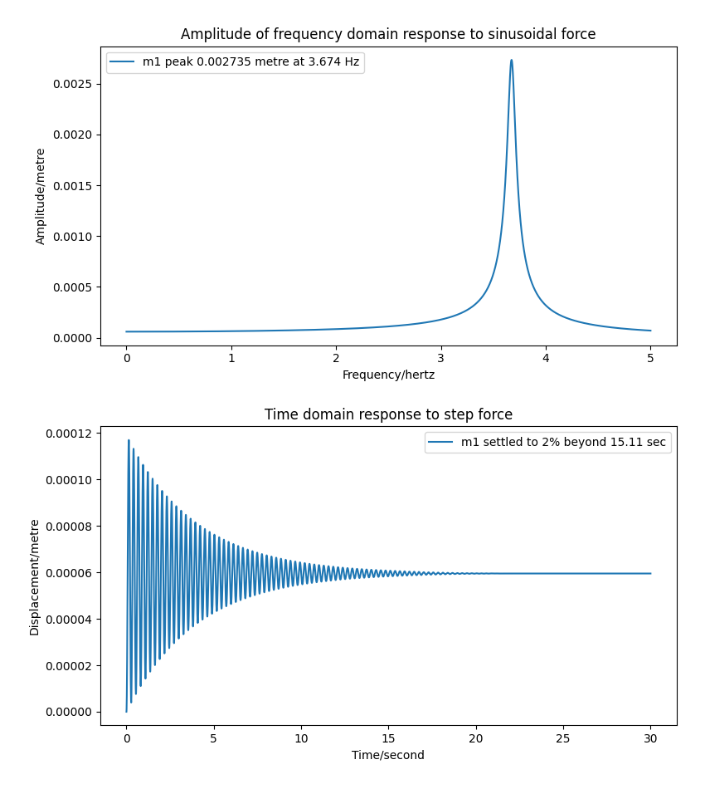

Varying N
Needed to vary the frequencies that the absorbers are tuned to.
Can be done in several arrangements (eg manually, uniformly spaced, normally spaced etc).
Keeping $k$ and $λ$ constant for each damper, changing $m$ to get to the chosen $ω_{t}$.
Used the values from A1 Lab as a baseline and started with 1 and 2 dof.

Slide 6
Variables to change
N
Number of dampers
Will affect the distribution and number of $ω_{t}$
Will affect the distribution and number of 𝜔_𝑡
$$ω_{t}$$
𝜔_𝑡
Distribution of frequencies TMDs are tuned to
Will affect $m$ according to $m=ω_{t}^{2}k$
Will affect 𝑚 according to 𝑚=𝜔_𝑡^2 𝑘
$λ_{n}$ and $k_{n}$
𝜆_𝑛 and 𝑘_𝑛
Initially kept constant
Changed afterwards to optimise performance

Slide 7

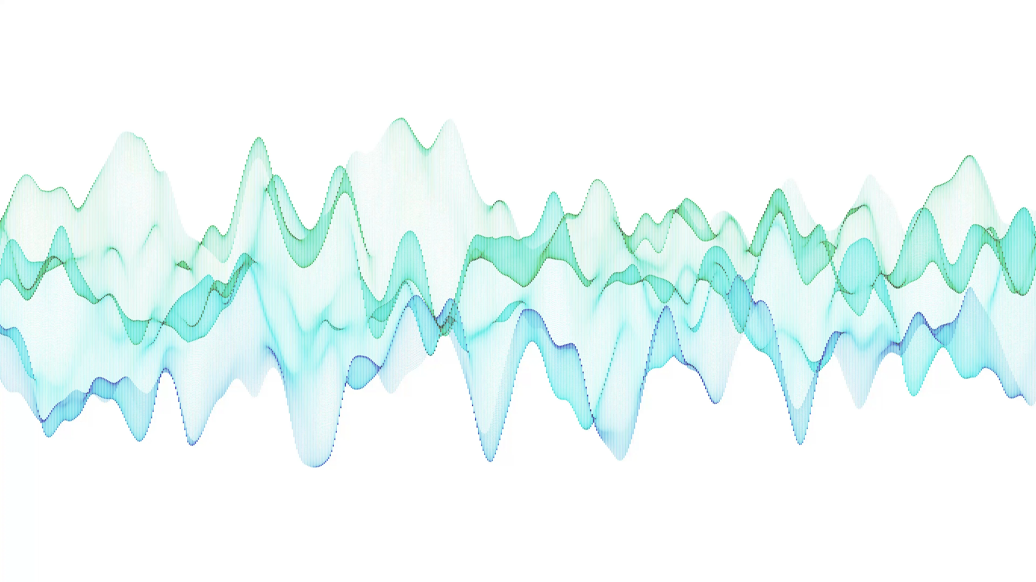
Frequency Response With N Dampers

Slide 8
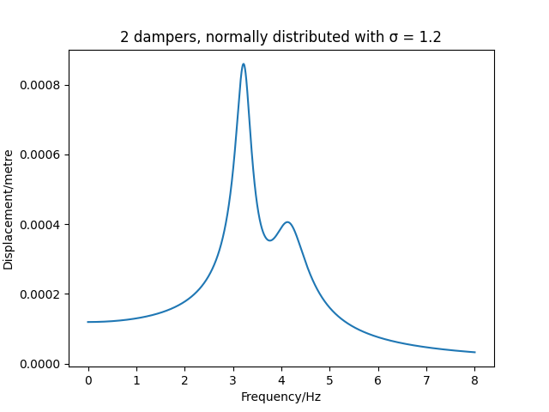
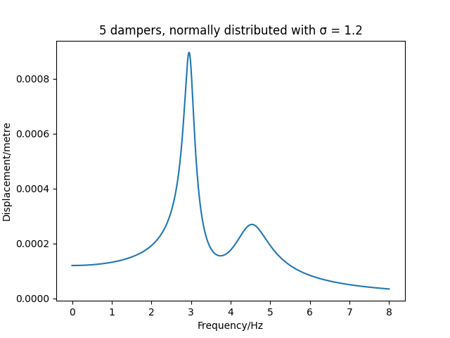
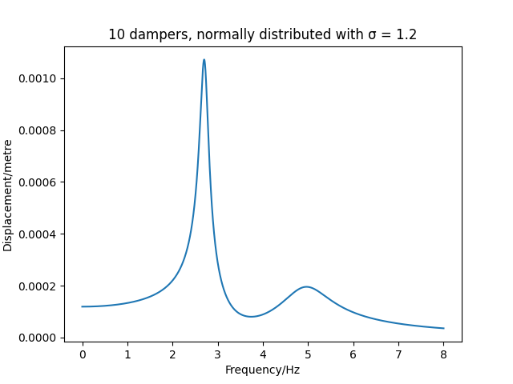
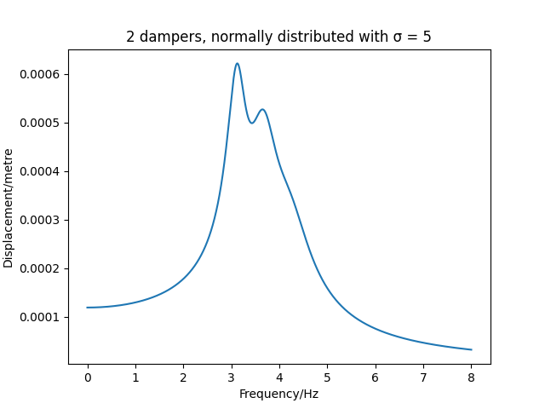
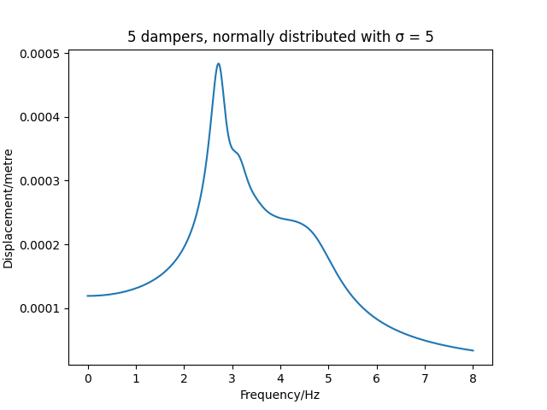
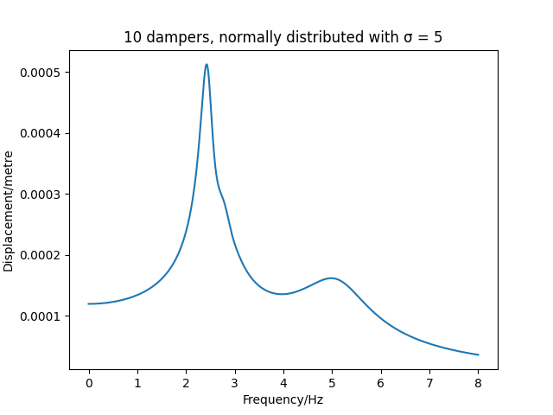
Adding dampers with normal distribution spacing
Notes:
- initially expected normal distribution to be the best
- not actually so good because the frequencies that are being tuned to are too close together effectively meaning they can be treated as a single TMD
- when the spacing was wider it performed better with smaller displacements for the buildinhg

Slide 9
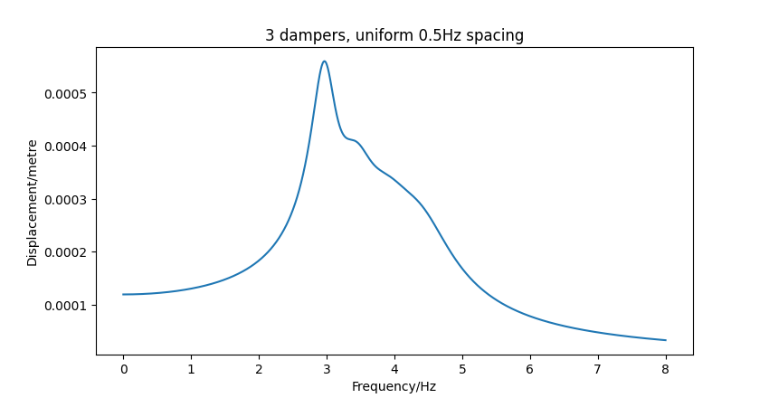
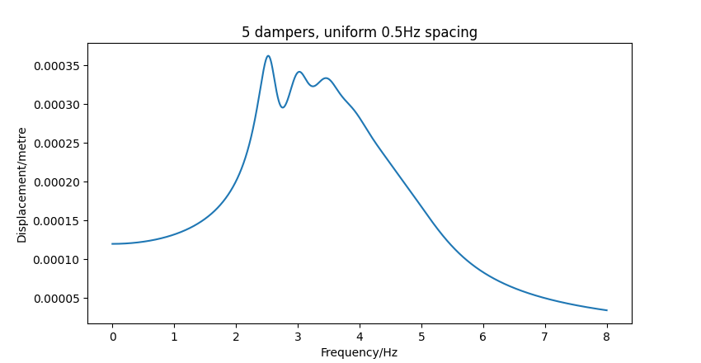
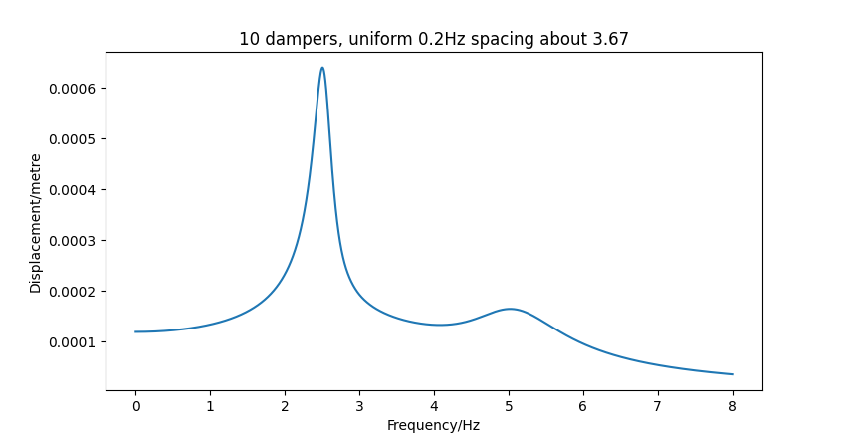
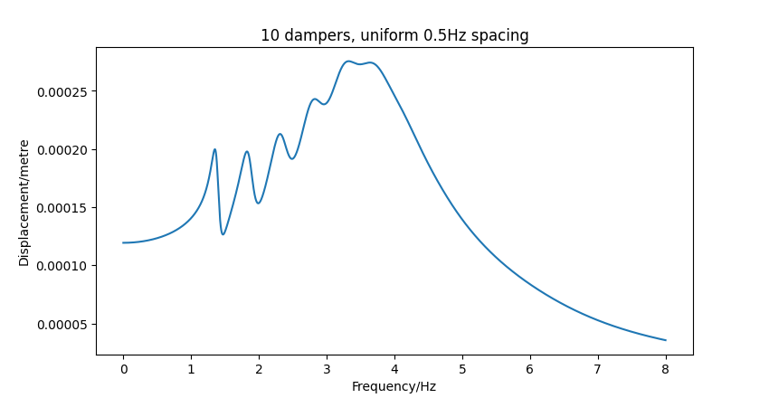
Adding dampers with uniform spacing
Notes:
- uniform performed very well but is still difficult to optimise for
- similar problem as before with a smaller spacing causing worse performance than wider spacing

Slide 10
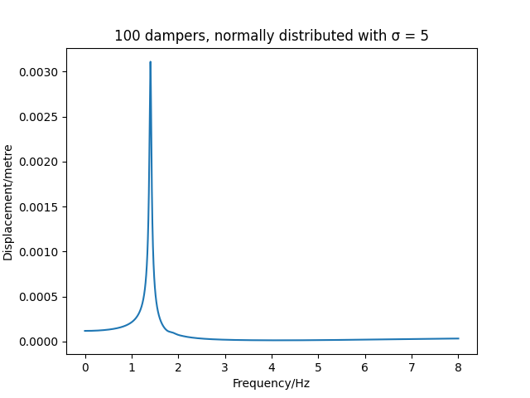
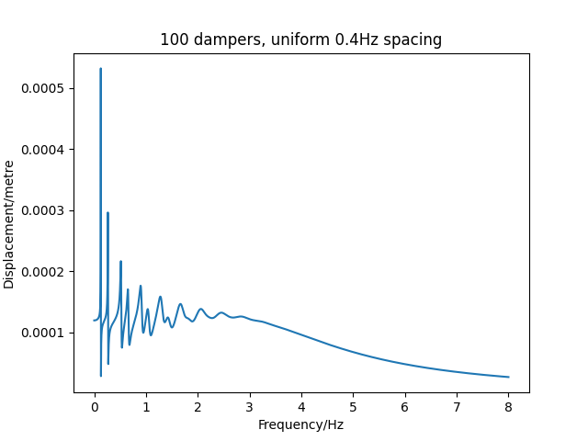
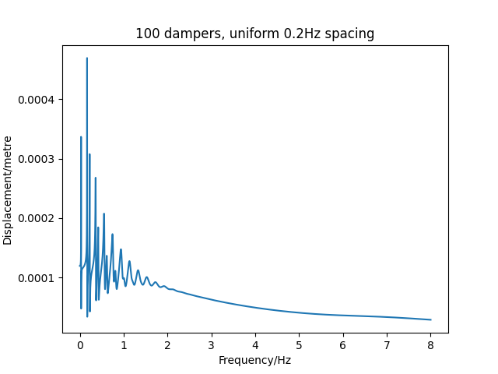
Adding many dampers (n=100)

Slide 11

Adding many dampers (n=100)
Adding too many dampers significantly reduces displacement of the building at most frequencies however brings the peak down to very low frequencies.
The distribution of the dampers plays a bigger role here.
The amplitude at the resonant frequency of the building ($f_{n}=3.67 Hz, ω_{n}=23.06 rad s^{−1}$) has been significantly brought down

Slide 12
Adding many dampers (n=100)
Adding too many dampers significantly reduces displacement of the building at most frequencies however brings the peak down to very low frequencies.
The distribution of the dampers plays a bigger role here.
The amplitude at the resonant frequency of the building ($f_{n}=3.67 Hz, ω_{n}=23.06 rad s^{−1}$) has been significantly brought down

Slide 13
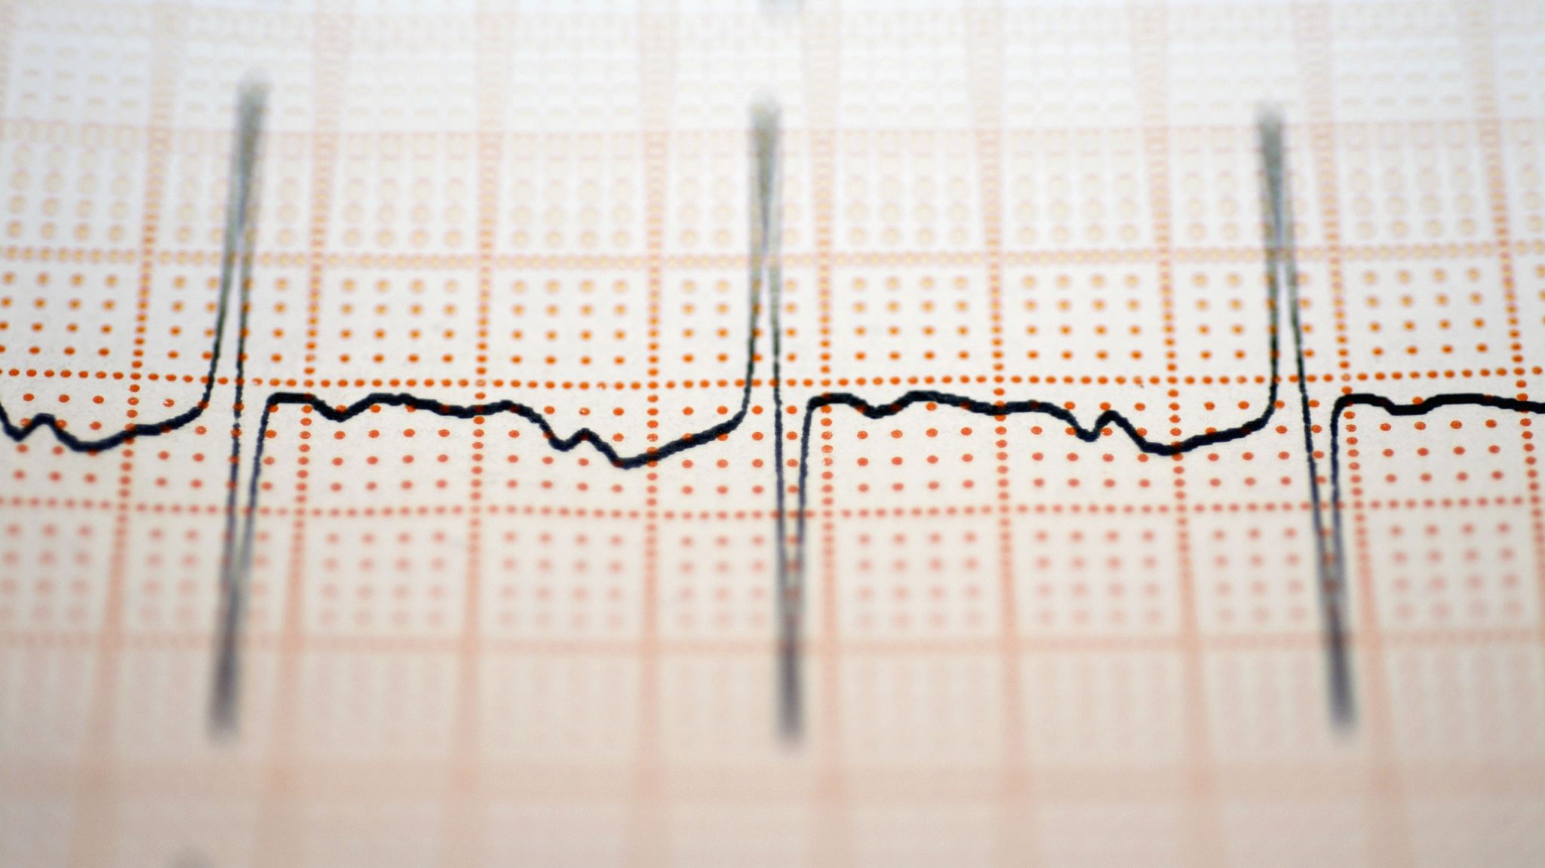
Impulse Response with N Dampers

Slide 14
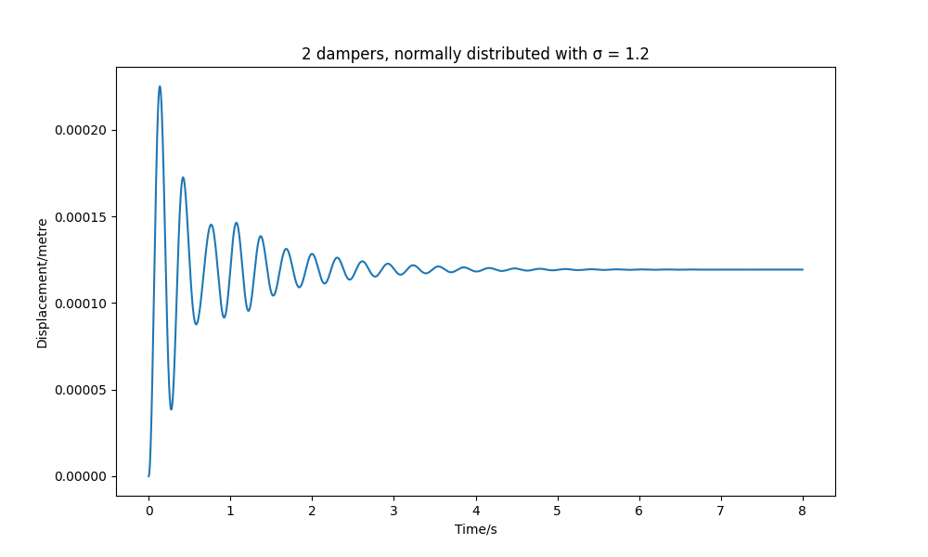
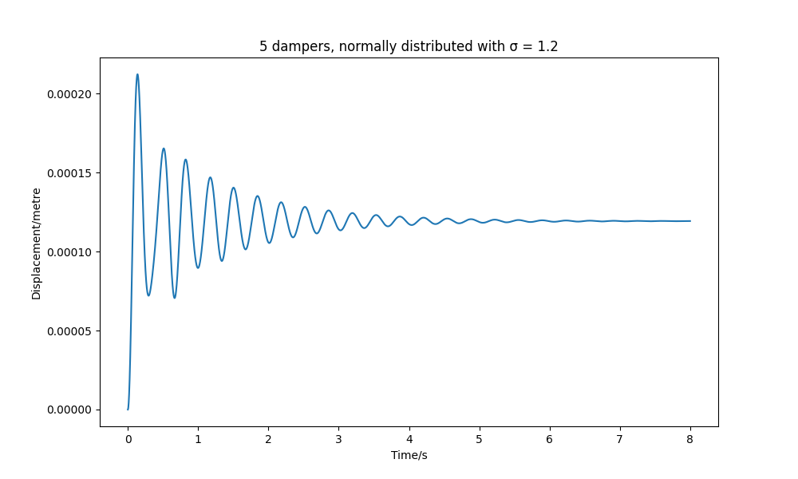
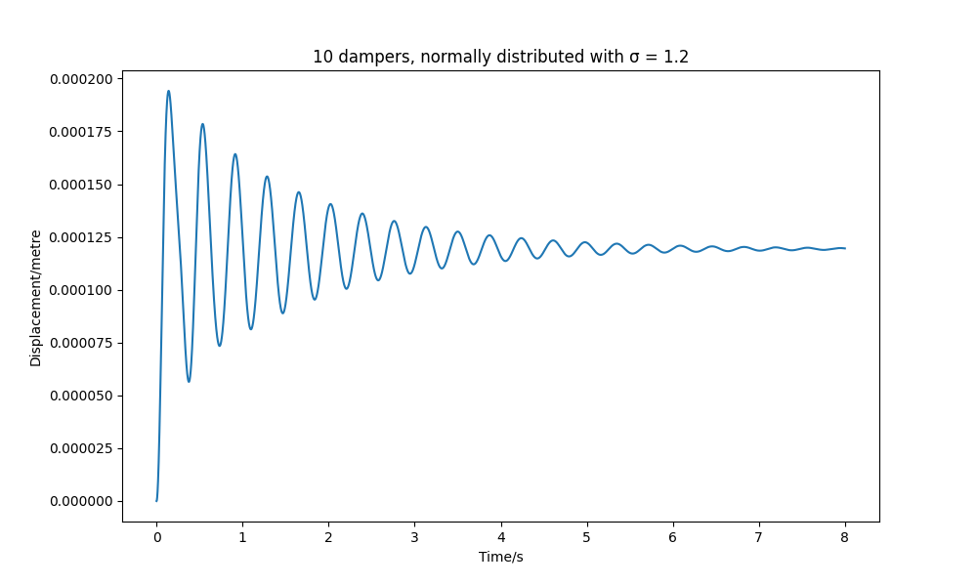
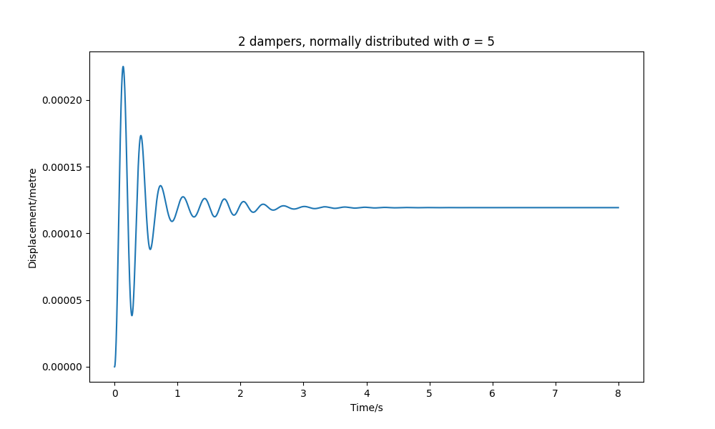
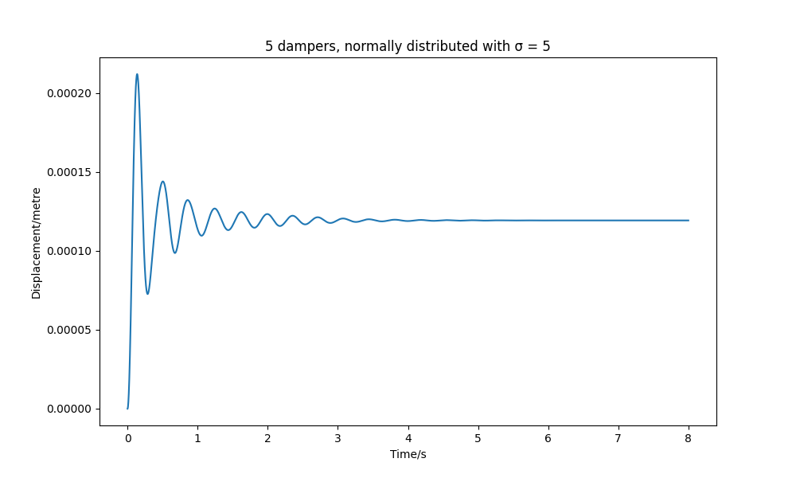
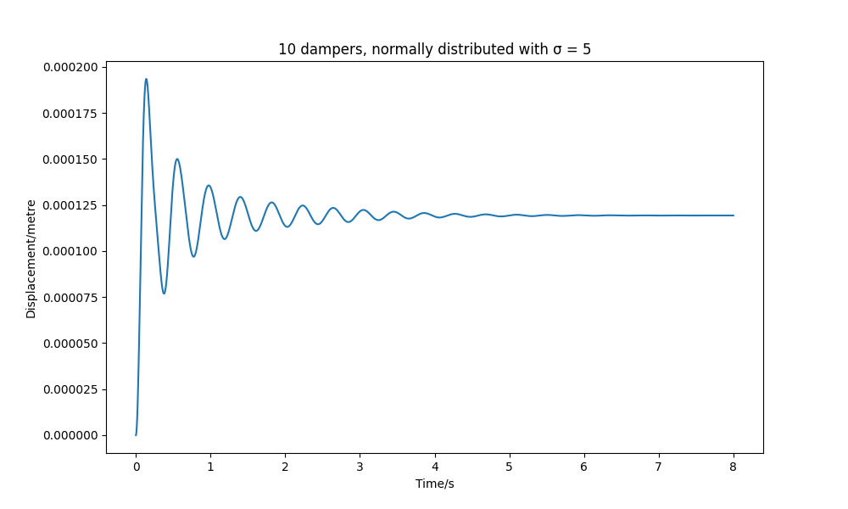
Adding dampers with normal distribution spacing
Notes:
- initially expected normal distribution to be the best
- not bad response when sigma is larger (more distributed)
- Overall very smooth response unlike uniform (change slide)

Slide 15
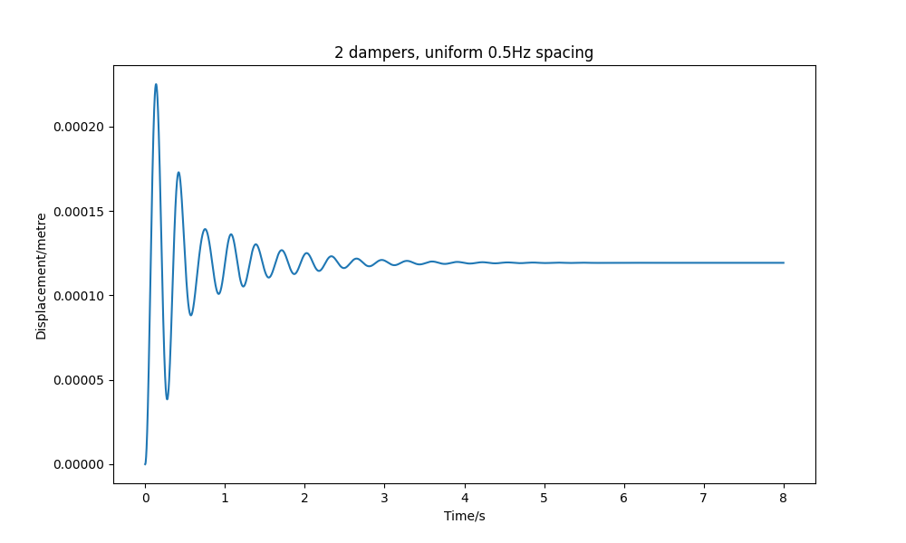
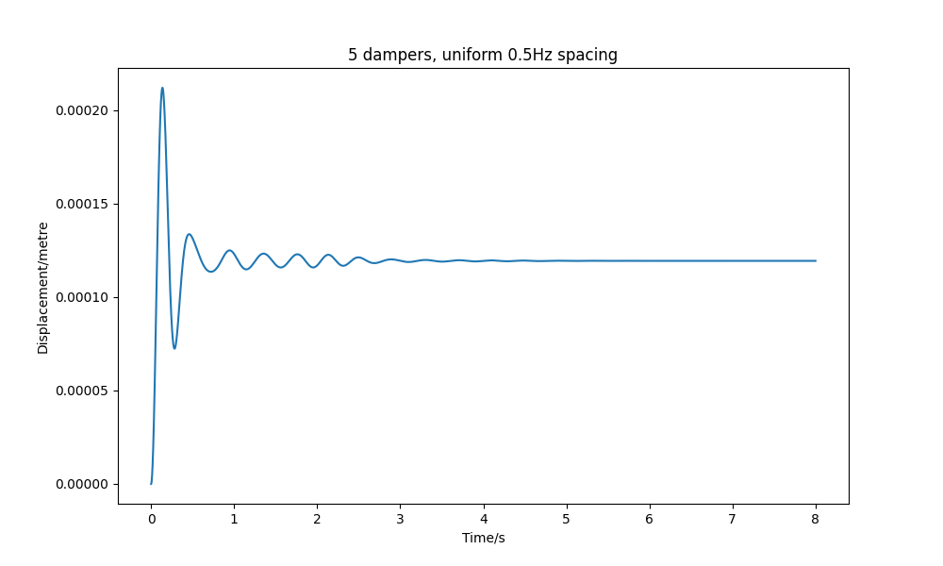
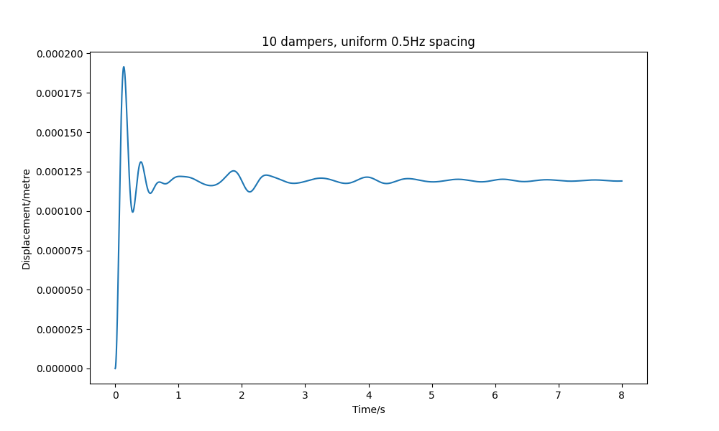
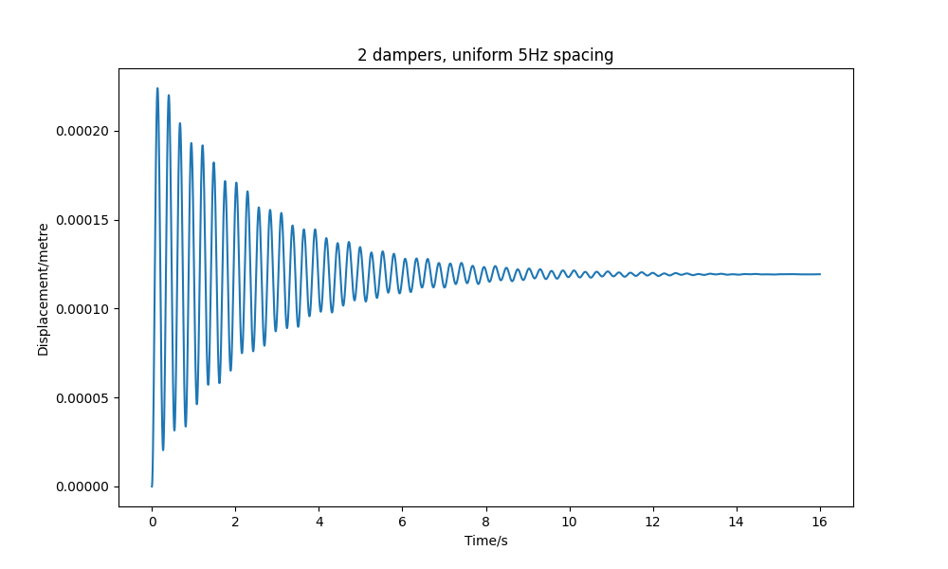
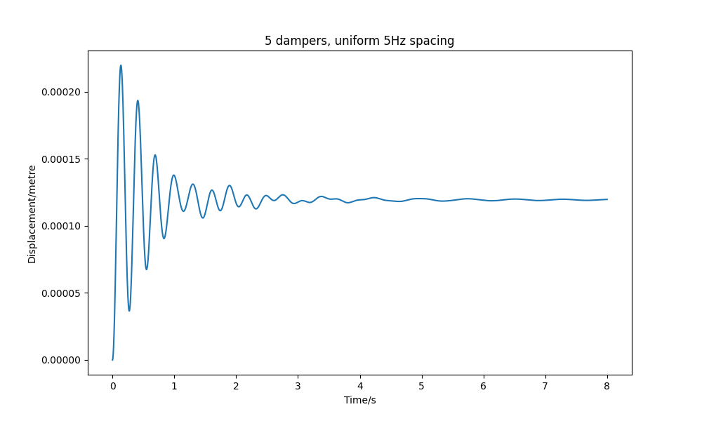
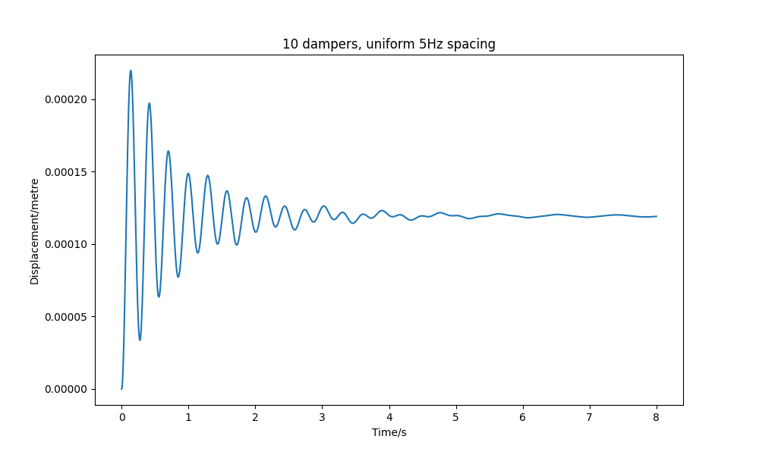
Adding dampers with uniform spacing
Notes:
- uniform performed very well but is still difficult to optimise for
- contrasting problem to before with a smaller spacing causing better performance than wider spacing
- too many dampers with different freq can cause weird effects like in top right and bottom middle

Slide 16
Automated TMD optimisation
Reaching a 90% amplitude reduction by setting the various parameters for each TMD either manually or by using a distribution proved to be challenging.
Using a computer model allows us to automate parameter optimisation.
As the number of TMDs increases, the number of potential combinations grows uncotrollably.
This means brute force isn't a feasible approach even with just 2 absorbers.
Using simulated annealing allows for more efficient searching of optimal values for many variables.
Further speed increases were achieved through parallel processing.

Slide 17
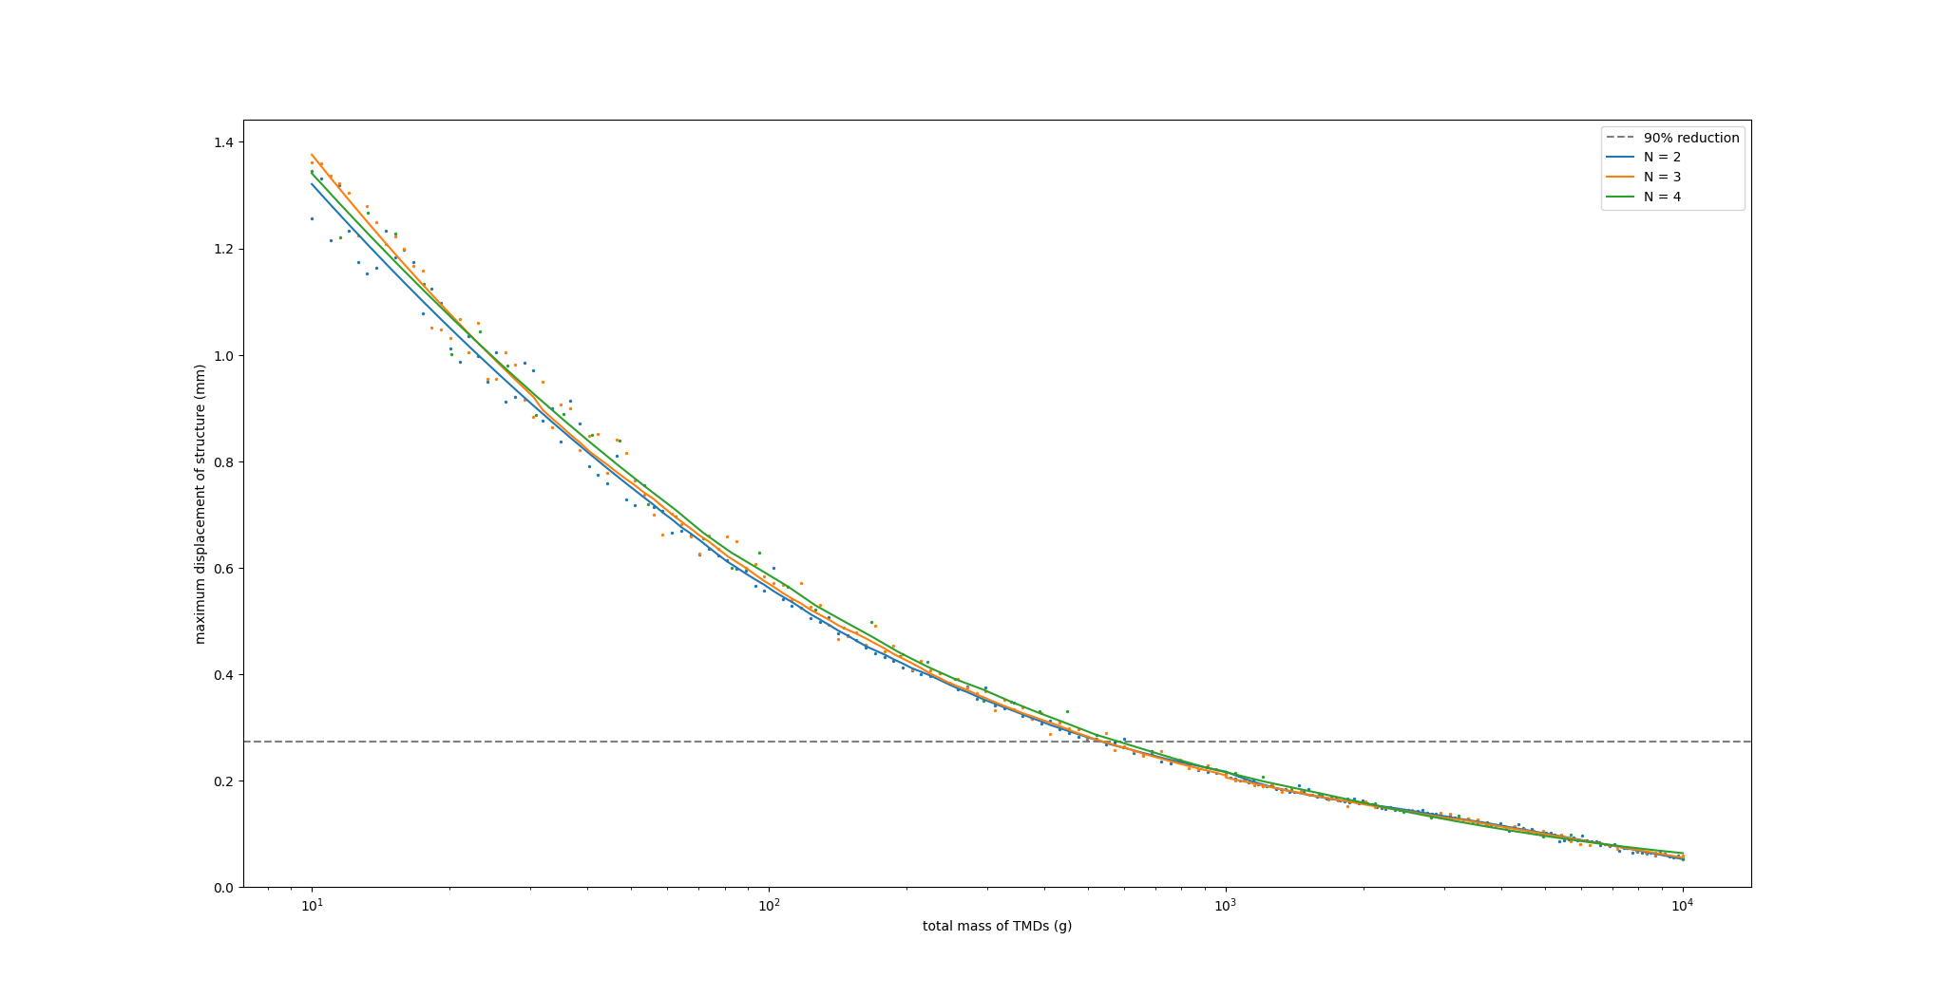

Slide 18
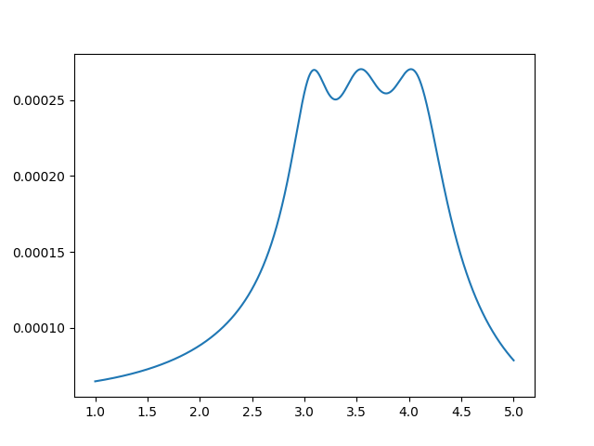
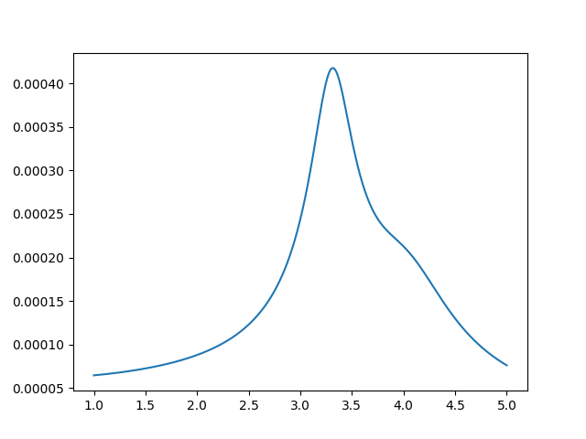

N = 2
TMD 1
$m$ = 298 g
$ω$ = 3.22 Hz
$ζ$ = 0.103
TMD 2
$m$ = 232 g
$ω$ = 3.76 Hz
$ζ$ = 0.109
Mass of the original structure is 7.88 kg, meaning that the TMDs increased the mass of the system by 6.7%
Using two TMDs provides a large benefit over just using one
N = 1

Slide 19


N = 2
Using more than 2 TMDs appears to offer no improvements in performance.
This may be caused by the optimisation algorithm getting stuck in a local minimum due to there being too many parameters for it to adjust, however we were not able to find any superior solutions.
N = 3
N = 4

Slide 20
Attempting to reduce independent variables
Despite using multiple methods of increasing the efficiency of optimisation, this too became infeasible as N increased further.
The previous plot required 6 million peak finding operations, which equates to solving approximately 1.5 billion matrix equations.
If we could find a relationship between optimal settings for the independent variables, the number of variables that need to be optimised would be reduced.

Slide 21
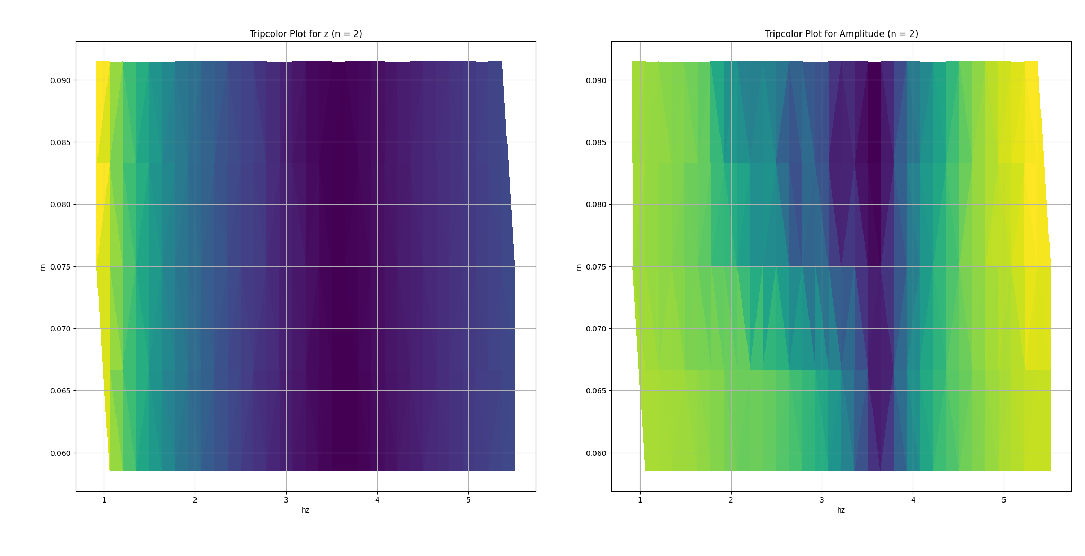

Slide 22
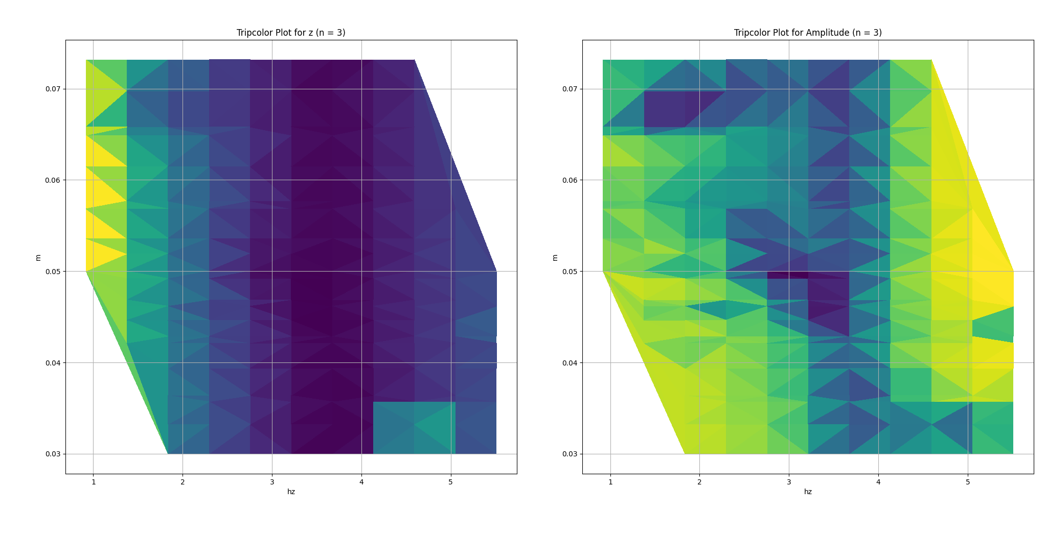

Slide 23
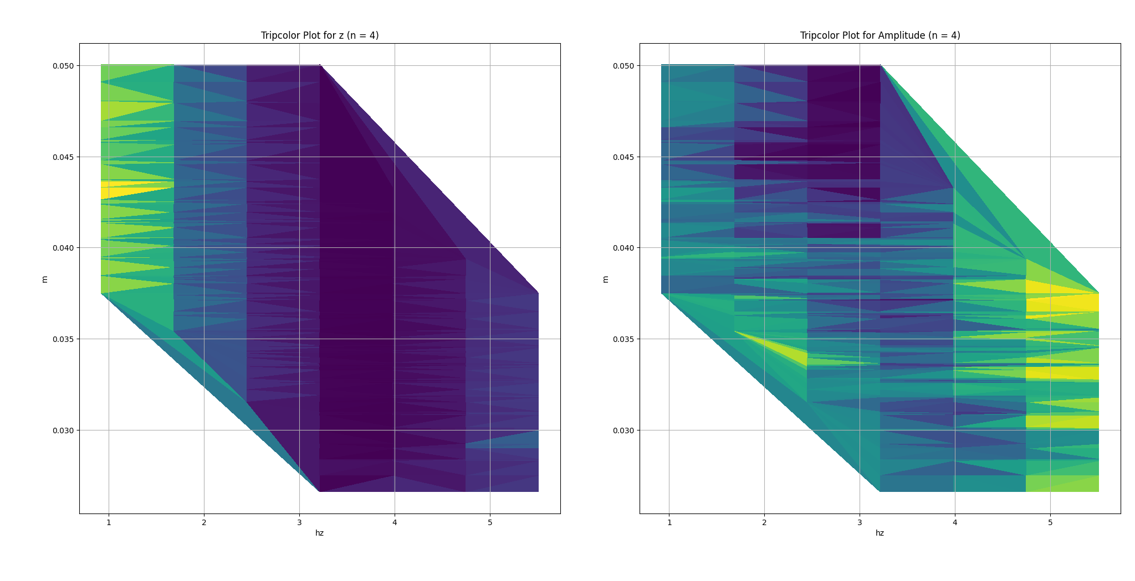

Slide 24
Conclusions

Slide 25
Conclusions
Adding a second TMD results in a substantial improvement over only using one.
Using more than two TMD provides some benefits when mass is not constant but has a smaller effect for every extra TMD
Using more than two TMDs at constant overall mass offers no additional benefit, unless it requires very precise tuning.
This would make the system very sensitive to manufacturing tolerances and temperature changes.
Analysis of numerous independent variables can be challenging even when able to test millions of configurations through computational methods.
Ideally these findings would be confirmed on a physical model structure, by using a sweep function to measure its frequency response.
Note, lower frequencies were explored due to these being the ones with the largest effects on buildings during earthquakes so a real test should sweep between 0 and 20Hz.

